Slide 1
PROJECT TITLE: Proactive Disaster Detection
PIP2001 Capstone Project
Review-1
Batch Number:CSD-G05
ROLL NUMBER | STUDENT NAME
20211CSD0052 | SWARNA LOHIT
20211CSD0050 | SANJAY S
20211CSD0199 | MANOJ M
Under the Supervision of,
Dr./Mr./Ms./Prof. Sandhya L
Professor / Associate Professor / Assistant Professor
School of Computer Science and Engineering
Presidency University
Name of the Program: B-TECH (CSE-DATA SCIENCE)
Name of the HoD: Dr. Saira Banu Atham
Name of the Program Project Coordinator: Prof. Sandhya L
Name of the School Project Coordinators: Dr. Sampath A K / Dr. Abdul Khadar A / Mr. Md Ziaur Rahman

Slide 2
Introduction
Floods are among the most destructive natural disasters, which are highly complex to model. The research on the advancement of flood prediction models contributed to risk reduction, policy suggestion, minimization of the loss of human life, and reduction of the property damage associated with floods. To mimic the complex mathematical expressions of physical processes of floods, during the past two decades, machine learning (ML) methods contributed highly in the advancement of prediction systems providing better performance and cost-effective solutions. Due to the vast benefits and potential of ML, its popularity dramatically increased among hydrologists. Researchers through introducing novel ML methods and hybridizing of the existing ones aim at discovering more accurate and efficient prediction models. The main contribution of this project is to demonstrate the state of the art of ML models in flood prediction and to give insight into the most suitable models. This project presents the Flood prediction and Rainfall analysis using Machine Learning. The main goal of employing this application is to prevent impacts of flood. This application can be easily used by the common people or government to predict the occurrence of flood beforehand.

Slide 3
Literature Review
Authors | Publication Year | Method/ Technology | Outcome | Limitations
Amir Mosavi, Pina, Ozturk, and Kwok-wing Chau | 2018 | Decision Trees and Ensemble models | Model was not able to predict accurate enough.(R² - 3.94) | Highly dependent on the quality and quantity of data. Poor data quality, lack of diversity, or insufficient data may result in unreliable predictions.
Parag Ghorpade, Hitesh Chordiya, Basavaraj Hooli, | 2021 | Linear Regression and SVM | Was not able to produce good accuracy | ML models is highly dependent on the availability and quality of regional data.
Yehai Tang, Yue Sun, Zhenyue Han, Shan-e-hyder Soomro | 2023 | K-Means Clustering and Random Forest | The study identified five common flood types based on rainfall and runoff characteristics. | The model struggled to accurately predict peak discharge for extreme floods, underestimating the values.
Authors
Publication Year
Method/ Technology
Outcome

Slide 4
Existing method Drawback
Data Quality: The performance of machine learning models is highly dependent on the quality and availability of data. In regions with limited or poor-quality data, the predictions can become unreliable.
Timing Errors: In certain cases, the flood peak times were predicted too early, with deviations ranging from 1 to 4 hours, which could limit the effectiveness of early warning systems.
Data Sensitivity: The accuracy of the machine learning models was highly sensitive to the quality, quantity, and diversity of the input data.
Challenges in Long-Term Predictions: While machine learning models were effective for short-term flood prediction, their long-term predictive capability was less robust.
Computational and Time Complexity: Machine learning models, particularly ensemble methods, neural networks, and hybrid models, can require substantial computational resources and time for training, testing, and deployment. This limits their practicality in real-time forecasting applications, especially in regions with limited technological infrastructure.

Slide 5
Objectives
The paper seeks to integrate the forecasted data into flood mapping techniques using GIS to create real-time inundation maps. These maps are intended to improve flood warning systems and disaster preparedness in areas prone to flooding.
The paper seeks to integrate the forecasted data into flood mapping techniques using GIS to create real-time inundation maps. These maps are intended to improve flood warning systems and disaster preparedness in areas prone to flooding.
The study aims to create a machine learning-based flood forecasting model that can accurately predict water levels in urban areas, even with limited data. It focuses on using a 2-variable sliding window technique to address data scarcity issues.
The paper seeks to integrate the forecasted data into flood mapping techniques using GIS to create real-time inundation maps. These maps are intended to improve flood warning systems and disaster preparedness in areas prone to flooding.
Ultimately, the research aims to contribute to more efficient flood risk management practices by providing timely and accurate flood warnings, especially in remote areas with limited monitoring infrastructure.

Slide 6
Methodology/Modules
Technology Stack Components:
Logistic Regression
Naive Bayes
K-Nearest Neighbors
Decision Tree Classifier
XgBoost
Libraries used:
NumPy
Pandas
Matplotlib
Date Time
Seaborn

Slide 7
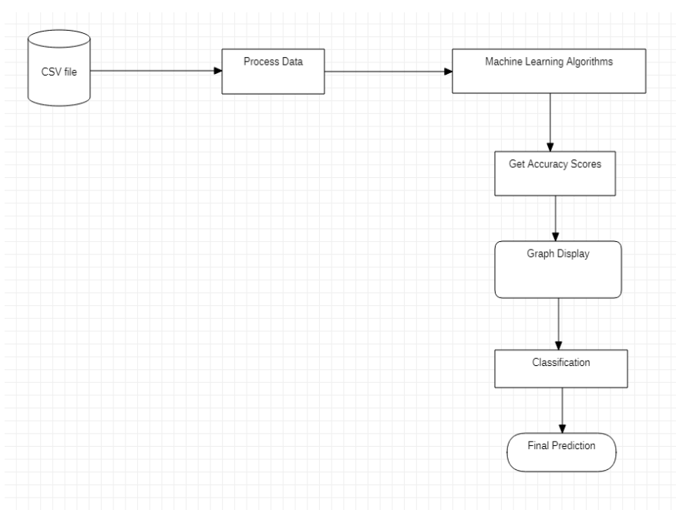
Architecture

Slide 8
Timeline of Project
Review 0 • 18-09-2024
Discuss the Approach of the
Problem Statement &
Identification
Review 2
Developing a Model using Machine
Learning Algorithms
Review 1
Data Collection and Preprocessing
From Sources
0
1
2
3
Final Viva
Voce
Review
Review 3
100% completion of project
With Working Code , and suitable Algorithm and Report
Final Viva-Voce
Live Demonstration of the project and submission of the Publication Paper

Slide 9
Expected Outcomes
To create a system that can quickly and accurately predict floods using rainfall data, helping improve early warnings, especially in smaller rivers​.
To make flood predictions more accurate and reliable than older methods, especially for predicting floods in the short term.
Flood forecasting by using patterns from past rainfall and flood data, making predictions quicker and more dependable​.

Slide 10
Conclusion
It is very important for India to predict flood as accurately as possible because only then, we will be able to alleviate the after-effects of floods. This Flood risk prediction system has been developed using machine learning that eliminates the extra efforts involved in manual estimation and provides the desired precision for decision-making. And we feel this could be the best prediction system if precision and accuracy are the highest priority. Former studies have revealed that Machine learning algorithms show considerable effectiveness for the preprocessing of environmental time-series datasets, as a precursor to the classification of flood data. For future improvement, we consider using other types of machine learning techniques, including the use of global optimization algorithms, for instance, the genetic algorithm that can expand the scope and scale of this study. In the future, this system will also be deployed on the web with additional features like sending warning SMS to authorities before the time that can help them plan safety measures for the people.

Slide 11
Github Link
GitHub Link :
https://github.com/swarna-lohitt/CSD-G05-Predicting-Natural-Disasters

Slide 12
References
Taherei Ghazvinei, P.; Hassanpour Darvishi, H.; Mosavi, A.; Yusof, K.B.W.; Alizamir, M.; Shamshirband, S.; Chau, K.W. Sugarcane growth prediction based on meteorological parameters using extreme learning machine and artificial neural network. Eng. Appl. Comput. Fluid Mech. 2018, 12, 738–749.
A. M. Kamal, M. Shamsudduha, B. Ahmed, S. K. Hassan, M. S. Islam, I. Kelman, and M. Fordham, “Resilience to flash floods in wetland communities of northeastern bangladesh,” International journal of disaster risk reduction, vol. 31, pp. 478-488, 2018.
H. Shafizadeh-Moghadam, R. Valavi, H. Shahabi, K. Chapi, and A. Shirzadi, “Novel forecasting approaches using combination of machine learning and statistical models for flood susceptibility mapping,” Journal o f environmental management, vol. 217, pp. 1-11, 2018.
DEVELOPING A FLOOD FORECASTING SYSTEM WITH MACHINE LEARNING AND APPLYING TO GEOGRAPHIC INFORMATION SYSTEM: DOI: 10.21163/GT_2023.181.01
Andrian, R., Naufal, M.A., Hermanto, B., Junaidi, A., and Lumbanraja, F.R. (2019). k-Nearest Neighbor (k-NN) Classification for Recognition of the Batik Lampung Motifs. Journal of Physics. 1338(2019) 012061. https://doi:10.1088/1742-6596/1338/1/012061

Slide 13

Project work mapping with SDG

Slide 14
Thank You

